Slide 1
Instructor Training Slides
MMPI®-3 Instructor Training Slides, University of Minnesota Press,
Copyright for all MMPI® materials are held by the Regents of the University of Minnesota

Slide 2
Part 3:
Unit 1: Interpretive Guidelines
Unit 2: Interpretation Worksheet
Unit 3: Validity Indicators
Unit 4: Substantive Scales
Part 3:
MMPI-3 Interpretation

Slide 3
Unit 1: Interpretive Guidelines

Slide 4
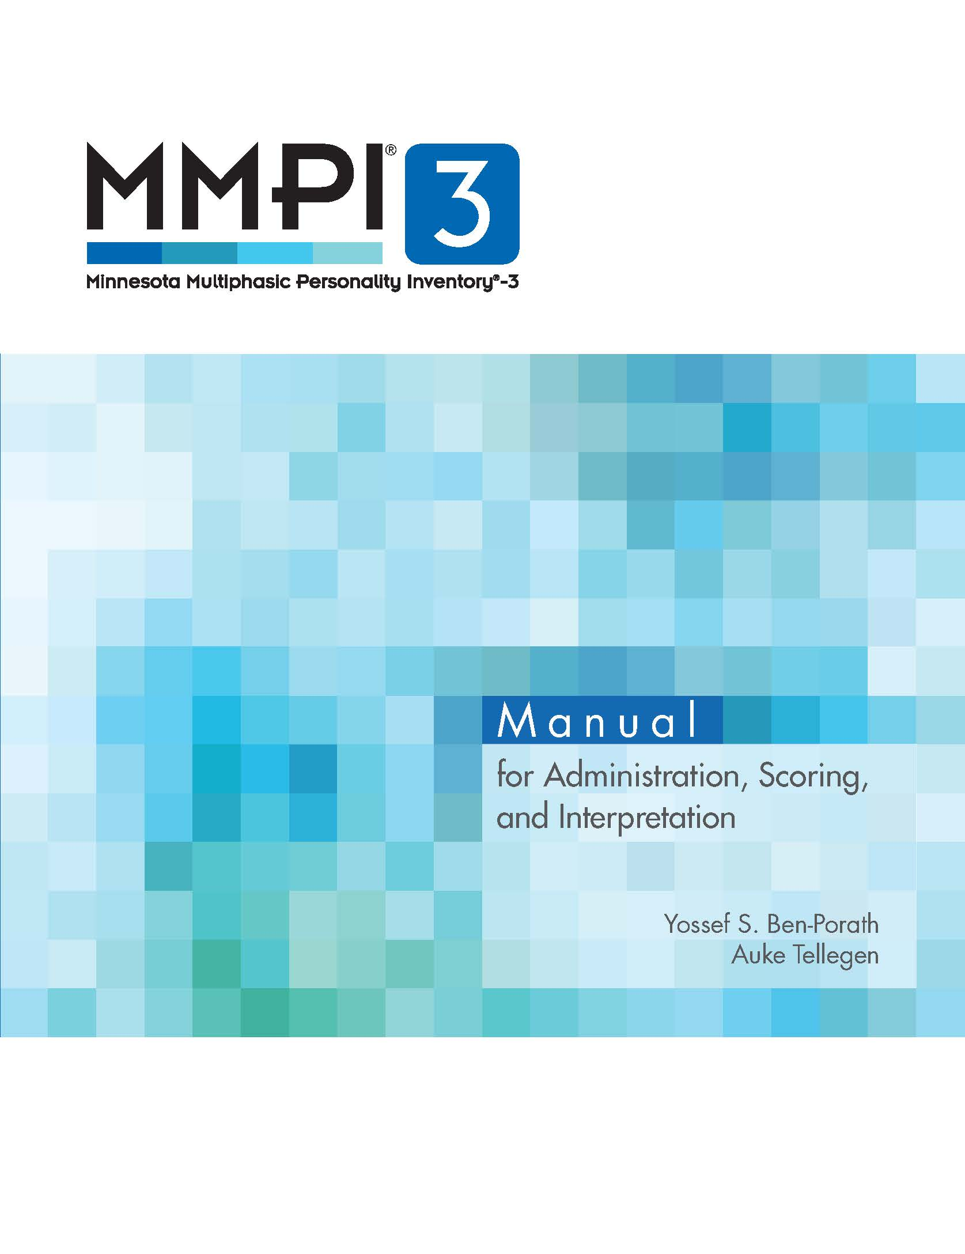
Manual for Administration, Scoring, and Interpretation
Chapter 5 includes information on:
  Structure for MMPI-3 interpretation
  Scale-by-scale interpretive
  recommendations
  Case illustrations

Slide 5
Structure of Interpretation
MMPI-3 Manual for Administration, Scoring, and Interpretation by Yossef S. Ben-Porath and Auke Tellegen. Copyright © 2020 by the Regents of the University of Minnesota. Reproduced by permission of the University of Minnesota Press. All rights reserved.

Slide 6
Structure of Interpretation
MMPI-3 Manual for Administration, Scoring, and Interpretation by Yossef S. Ben-Porath and Auke Tellegen. Copyright © 2020 by the Regents of the University of Minnesota. Reproduced by permission of the University of Minnesota Press. All rights reserved.

Slide 7
Structure of Interpretation
MMPI-3 Manual for Administration, Scoring, and Interpretation by Yossef S. Ben-Porath and Auke Tellegen. Copyright © 2020 by the Regents of the University of Minnesota. Reproduced by permission of the University of Minnesota Press. All rights reserved.

Slide 8
Structure of Interpretation
MMPI-3 Manual for Administration, Scoring, and Interpretation by Yossef S. Ben-Porath and Auke Tellegen. Copyright © 2020 by the Regents of the University of Minnesota. Reproduced by permission of the University of Minnesota Press. All rights reserved.

Slide 9
Structure of Interpretation
MMPI-3 Manual for Administration, Scoring, and Interpretation by Yossef S. Ben-Porath and Auke Tellegen. Copyright © 2020 by the Regents of the University of Minnesota. Reproduced by permission of the University of Minnesota Press. All rights reserved.

Slide 10
Structure of Interpretation
MMPI-3 Manual for Administration, Scoring, and Interpretation by Yossef S. Ben-Porath and Auke Tellegen. Copyright © 2020 by the Regents of the University of Minnesota. Reproduced by permission of the University of Minnesota Press. All rights reserved.

Slide 11
Structure of Interpretation
MMPI-3 Manual for Administration, Scoring, and Interpretation by Yossef S. Ben-Porath and Auke Tellegen. Copyright © 2020 by the Regents of the University of Minnesota. Reproduced by permission of the University of Minnesota Press. All rights reserved.

Slide 12
Structure of Interpretation
MMPI-3 Manual for Administration, Scoring, and Interpretation by Yossef S. Ben-Porath and Auke Tellegen. Copyright © 2020 by the Regents of the University of Minnesota. Reproduced by permission of the University of Minnesota Press. All rights reserved.

Slide 13
Structure of Interpretation
MMPI-3 Manual for Administration, Scoring, and Interpretation by Yossef S. Ben-Porath and Auke Tellegen. Copyright © 2020 by the Regents of the University of Minnesota. Reproduced by permission of the University of Minnesota Press. All rights reserved.

Slide 14
Structure of Interpretation
MMPI-3 Manual for Administration, Scoring, and Interpretation by Yossef S. Ben-Porath and Auke Tellegen. Copyright © 2020 by the Regents of the University of Minnesota. Reproduced by permission of the University of Minnesota Press. All rights reserved.

Slide 15
Structure of Interpretation
MMPI-3 Manual for Administration, Scoring, and Interpretation by Yossef S. Ben-Porath and Auke Tellegen. Copyright © 2020 by the Regents of the University of Minnesota. Reproduced by permission of the University of Minnesota Press. All rights reserved.

Slide 16
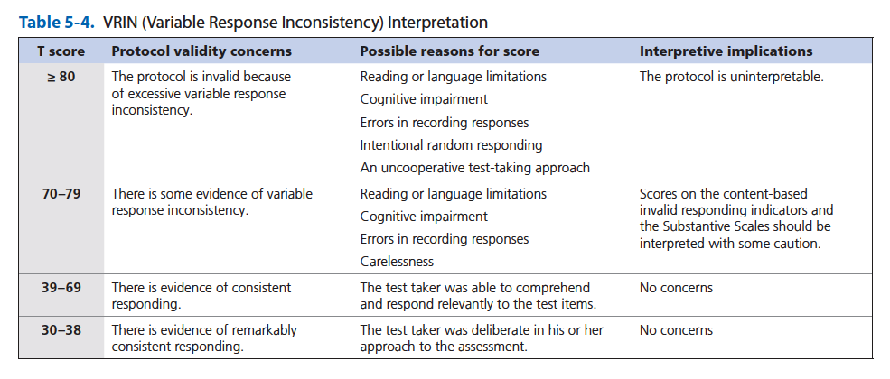
Scale-by-Scale Interpretive Recommendations: Validity Scales
MMPI-3 Manual for Administration, Scoring, and Interpretation by Yossef S. Ben-Porath and Auke Tellegen. Copyright © 2020 by the Regents of the University of Minnesota. Reproduced by permission of the University of Minnesota Press. All rights reserved.

Slide 17
Scale-by-Scale Interpretive Recommendations: Validity Scales
MMPI-3 Manual for Administration, Scoring, and Interpretation by Yossef S. Ben-Porath and Auke Tellegen. Copyright © 2020 by the Regents of the University of Minnesota. Reproduced by permission of the University of Minnesota Press. All rights reserved.

Slide 18
Scale-by-Scale Interpretive Recommendations: Validity Scales
MMPI-3 Manual for Administration, Scoring, and Interpretation by Yossef S. Ben-Porath and Auke Tellegen. Copyright © 2020 by the Regents of the University of Minnesota. Reproduced by permission of the University of Minnesota Press. All rights reserved.

Slide 19
Scale-by-Scale Interpretive Recommendations: Validity Scales
MMPI-3 Manual for Administration, Scoring, and Interpretation by Yossef S. Ben-Porath and Auke Tellegen. Copyright © 2020 by the Regents of the University of Minnesota. Reproduced by permission of the University of Minnesota Press. All rights reserved.

Slide 20
Scale-by-Scale Interpretive Recommendations: Validity Scales
MMPI-3 Manual for Administration, Scoring, and Interpretation by Yossef S. Ben-Porath and Auke Tellegen. Copyright © 2020 by the Regents of the University of Minnesota. Reproduced by permission of the University of Minnesota Press. All rights reserved.

Slide 21
Scale-by-Scale Interpretive Recommendations: Validity Scales
MMPI-3 Manual for Administration, Scoring, and Interpretation by Yossef S. Ben-Porath and Auke Tellegen. Copyright © 2020 by the Regents of the University of Minnesota. Reproduced by permission of the University of Minnesota Press. All rights reserved.

Slide 22
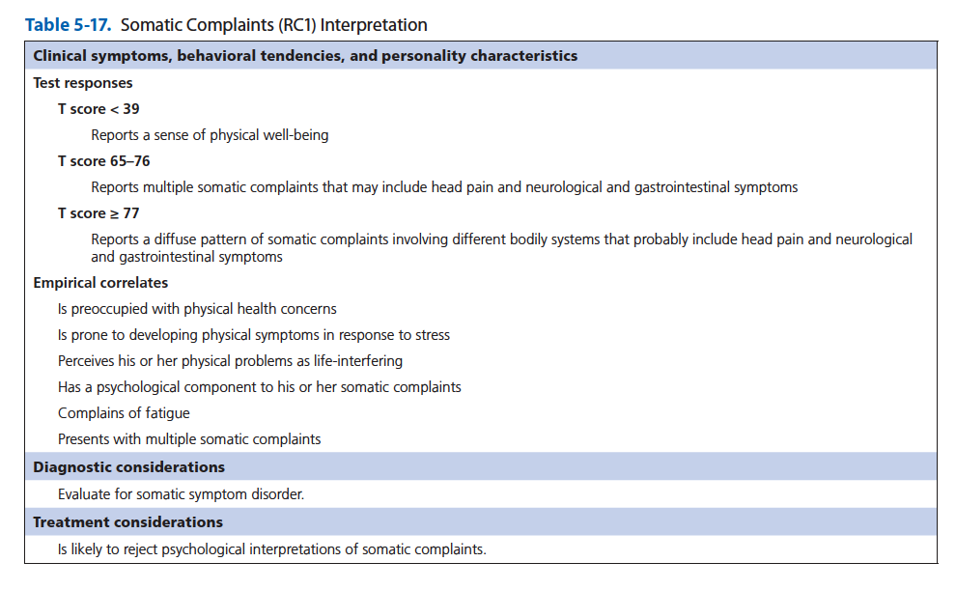
Scale-by-Scale Interpretive Recommendations: Substantive Scales
MMPI-3 Manual for Administration, Scoring, and Interpretation by Yossef S. Ben-Porath and Auke Tellegen. Copyright © 2020 by the Regents of the University of Minnesota. Reproduced by permission of the University of Minnesota Press. All rights reserved.

Slide 23
Scale-by-Scale Interpretive Recommendations: Substantive Scales
MMPI-3 Manual for Administration, Scoring, and Interpretation by Yossef S. Ben-Porath and Auke Tellegen. Copyright © 2020 by the Regents of the University of Minnesota. Reproduced by permission of the University of Minnesota Press. All rights reserved.

Slide 24
Scale-by-Scale Interpretive Recommendations: Substantive Scales
MMPI-3 Manual for Administration, Scoring, and Interpretation by Yossef S. Ben-Porath and Auke Tellegen. Copyright © 2020 by the Regents of the University of Minnesota. Reproduced by permission of the University of Minnesota Press. All rights reserved.

Slide 25
Scale-by-Scale Interpretive Recommendations: Substantive Scales
MMPI-3 Manual for Administration, Scoring, and Interpretation by Yossef S. Ben-Porath and Auke Tellegen. Copyright © 2020 by the Regents of the University of Minnesota. Reproduced by permission of the University of Minnesota Press. All rights reserved.

Slide 26
Scale-by-Scale Interpretive Recommendations: Substantive Scales
MMPI-3 Manual for Administration, Scoring, and Interpretation by Yossef S. Ben-Porath and Auke Tellegen. Copyright © 2020 by the Regents of the University of Minnesota. Reproduced by permission of the University of Minnesota Press. All rights reserved.

Slide 27
Scale-by-Scale Interpretive Recommendations: Substantive Scales
MMPI-3 Manual for Administration, Scoring, and Interpretation by Yossef S. Ben-Porath and Auke Tellegen. Copyright © 2020 by the Regents of the University of Minnesota. Reproduced by permission of the University of Minnesota Press. All rights reserved.

Slide 28
Scale-by-Scale Interpretive Recommendations: Substantive Scales
MMPI-3 Manual for Administration, Scoring, and Interpretation by Yossef S. Ben-Porath and Auke Tellegen. Copyright © 2020 by the Regents of the University of Minnesota. Reproduced by permission of the University of Minnesota Press. All rights reserved.

Slide 29
Scale-by-Scale Interpretive Recommendations: Substantive Scales
MMPI-3 Manual for Administration, Scoring, and Interpretation by Yossef S. Ben-Porath and Auke Tellegen. Copyright © 2020 by the Regents of the University of Minnesota. Reproduced by permission of the University of Minnesota Press. All rights reserved.

Slide 30
Scale-by-Scale Interpretive Recommendations: Substantive Scales
MMPI-3 Manual for Administration, Scoring, and Interpretation by Yossef S. Ben-Porath and Auke Tellegen. Copyright © 2020 by the Regents of the University of Minnesota. Reproduced by permission of the University of Minnesota Press. All rights reserved.

Slide 31
Scale-by-Scale Interpretive Recommendations: Substantive Scales
MMPI-3 Manual for Administration, Scoring, and Interpretation by Yossef S. Ben-Porath and Auke Tellegen. Copyright © 2020 by the Regents of the University of Minnesota. Reproduced by permission of the University of Minnesota Press. All rights reserved.

Slide 32
Scale-by-Scale Interpretive Recommendations: Substantive Scales
MMPI-3 Manual for Administration, Scoring, and Interpretation by Yossef S. Ben-Porath and Auke Tellegen. Copyright © 2020 by the Regents of the University of Minnesota. Reproduced by permission of the University of Minnesota Press. All rights reserved.

Slide 33
Scale-by-Scale Interpretive Recommendations: Substantive Scales
MMPI-3 Manual for Administration, Scoring, and Interpretation by Yossef S. Ben-Porath and Auke Tellegen. Copyright © 2020 by the Regents of the University of Minnesota. Reproduced by permission of the University of Minnesota Press. All rights reserved.

Slide 34
Scale-by-Scale Interpretive Recommendations: Substantive Scales
MMPI-3 Manual for Administration, Scoring, and Interpretation by Yossef S. Ben-Porath and Auke Tellegen. Copyright © 2020 by the Regents of the University of Minnesota. Reproduced by permission of the University of Minnesota Press. All rights reserved.

Slide 35
Scale-by-Scale Interpretive Recommendations: Substantive Scales
MMPI-3 Manual for Administration, Scoring, and Interpretation by Yossef S. Ben-Porath and Auke Tellegen. Copyright © 2020 by the Regents of the University of Minnesota. Reproduced by permission of the University of Minnesota Press. All rights reserved.

Slide 36
Scale-by-Scale Interpretive Recommendations: Substantive Scales
MMPI-3 Manual for Administration, Scoring, and Interpretation by Yossef S. Ben-Porath and Auke Tellegen. Copyright © 2020 by the Regents of the University of Minnesota. Reproduced by permission of the University of Minnesota Press. All rights reserved.

Slide 37
Unit 2: Interpretation Worksheet

Slide 38
MMPI-3 Interpretation worksheet
Designed to facilitate interpretation following the guidelines in Chapter 5 of the MMPI-3 Manual for Administration, Scoring, and Interpretation
Used in conjunction with MMPI-3 T Scores (By Domain) page (7) of the Score Report and Clinical Interpretive Report

Slide 50
When to use the worksheet
When first learning to interpret the
MMPI-3
If you do not routinely use the MMPI-3
When you want to be sure not to miss any important interpretive information
If you want all the interpretive guidance available in the MMPI-3 Interpretive Report for Clinical Settings

Slide 51
Unit 3: Validity Indicators

Slide 52
Two uses of “Validity”
Instrument validity
  Refers to the psychometric properties of scale scores
    Concurrent validity
    Predictive validity
    Discriminant validity
  Information about this type of validity should influence test selection/use decisions
Protocol validity
  A protocol (test that an individual takes) may be invalid, regardless of instrument validity
  Several threats to protocol validity exist

Slide 53
Threats to Protocol Validity
Non-Content Based
  Non-responding
  Random Responding
  Fixed Responding
Content-Based Invalid Responding
  Over-Reporting
    Intentional
      Exaggeration / Fabrication
    Unintentional
  Under-Reporting
    Intentional
      Minimization / Denial
    Unintentional

Slide 54
MMPI-3 Validity Scales
CRIN Combined Response Inconsistency – Combination of variable and fixed inconsistent responding
VRIN Variable Response Inconsistency – Variable inconsistent responding
TRIN True Response Inconsistency – Fixed inconsistent responding
F Infrequent Responses – Responses infrequent in the general population
Fp Infrequent Psychopathology Responses – Responses infrequent in psychiatric populations
Fs Infrequent Somatic Responses – Somatic complaints infrequent in medical patient populations
FBS Symptom Validity Scale – Noncredible somatic and cognitive complaints
RBS Response Bias Scale – Exaggerated memory complaints
L Uncommon Virtues – Rarely claimed moral attributes or activities
K Adjustment Validity – Claims of uncommonly high level of psychological adjustment

Slide 55
Threats to Protocol Validity
Challenge to MMPI-3 Validity Scale interpretation:
  Confounds

Slide 56
Adapted from Interpreting the MMPI-2-RF by Yossef S. Ben-Porath. Copyright © 2012 by the Regents of the University of Minnesota. Reproduced by permission of the University of Minnesota Press.

Slide 57
Adapted from Interpreting the MMPI-2-RF by Yossef S. Ben-Porath. Copyright © 2012 by the Regents of the University of Minnesota. Reproduced by permission of the University of Minnesota Press.

Slide 58
Adapted from Interpreting the MMPI-2-RF by Yossef S. Ben-Porath. Copyright © 2012 by the Regents of the University of Minnesota. Reproduced by permission of the University of Minnesota Press.

Slide 59
Adapted from Interpreting the MMPI-2-RF by Yossef S. Ben-Porath. Copyright © 2012 by the Regents of the University of Minnesota. Reproduced by permission of the University of Minnesota Press.

Slide 60
Adapted from Interpreting the MMPI-2-RF by Yossef S. Ben-Porath. Copyright © 2012 by the Regents of the University of Minnesota. Reproduced by permission of the University of Minnesota Press.

Slide 61
Adapted from Interpreting the MMPI-2-RF by Yossef S. Ben-Porath. Copyright © 2012 by the Regents of the University of Minnesota. Reproduced by permission of the University of Minnesota Press.

Slide 62
Adapted from Interpreting the MMPI-2-RF by Yossef S. Ben-Porath. Copyright © 2012 by the Regents of the University of Minnesota. Reproduced by permission of the University of Minnesota Press.

Slide 63
Adapted from Interpreting the MMPI-2-RF by Yossef S. Ben-Porath. Copyright © 2012 by the Regents of the University of Minnesota. Reproduced by permission of the University of Minnesota Press.

Slide 64
Adapted from Interpreting the MMPI-2-RF by Yossef S. Ben-Porath. Copyright © 2012 by the Regents of the University of Minnesota. Reproduced by permission of the University of Minnesota Press.

Slide 65
Adapted from Interpreting the MMPI-2-RF by Yossef S. Ben-Porath. Copyright © 2012 by the Regents of the University of Minnesota. Reproduced by permission of the University of Minnesota Press.

Slide 66
Adapted from Interpreting the MMPI-2-RF by Yossef S. Ben-Porath. Copyright © 2012 by the Regents of the University of Minnesota. Reproduced by permission of the University of Minnesota Press.

Slide 67
Adapted from Interpreting the MMPI-2-RF by Yossef S. Ben-Porath. Copyright © 2012 by the Regents of the University of Minnesota. Reproduced by permission of the University of Minnesota Press.

Slide 68
Adapted from Interpreting the MMPI-2-RF by Yossef S. Ben-Porath. Copyright © 2012 by the Regents of the University of Minnesota. Reproduced by permission of the University of Minnesota Press.

Slide 69
Adapted from Interpreting the MMPI-2-RF by Yossef S. Ben-Porath. Copyright © 2012 by the Regents of the University of Minnesota. Reproduced by permission of the University of Minnesota Press.

Slide 70
Adapted from Interpreting the MMPI-2-RF by Yossef S. Ben-Porath. Copyright © 2012 by the Regents of the University of Minnesota. Reproduced by permission of the University of Minnesota Press.

Slide 71
Adapted from Interpreting the MMPI-2-RF by Yossef S. Ben-Porath. Copyright © 2012 by the Regents of the University of Minnesota. Reproduced by permission of the University of Minnesota Press.

Slide 72
Adapted from Interpreting the MMPI-2-RF by Yossef S. Ben-Porath. Copyright © 2012 by the Regents of the University of Minnesota. Reproduced by permission of the University of Minnesota Press.

Slide 73
Adapted from Interpreting the MMPI-2-RF by Yossef S. Ben-Porath. Copyright © 2012 by the Regents of the University of Minnesota. Reproduced by permission of the University of Minnesota Press.

Slide 74
Adapted from Interpreting the MMPI-2-RF by Yossef S. Ben-Porath. Copyright © 2012 by the Regents of the University of Minnesota. Reproduced by permission of the University of Minnesota Press.

Slide 75
Adapted from Interpreting the MMPI-2-RF by Yossef S. Ben-Porath. Copyright © 2012 by the Regents of the University of Minnesota. Reproduced by permission of the University of Minnesota Press.

Slide 76
Adapted from Interpreting the MMPI-2-RF by Yossef S. Ben-Porath. Copyright © 2012 by the Regents of the University of Minnesota. Reproduced by permission of the University of Minnesota Press.

Slide 77
Threats to Protocol Validity
Challenge to MMPI-3 Validity Scale interpretation:
  Confounds
Interpretive guidelines in Chapter 5 incorporate consideration of potential confounds

Slide 78
Adapted from Interpreting the MMPI-2-RF by Yossef S. Ben-Porath. Copyright © 2012 by the Regents of the University of Minnesota. Reproduced by permission of the University of Minnesota Press.

Slide 82
Unit 4: Substantive Scales

Slide 83
Substantive Scale Interpretation
Substantive Scales
  Begin with Higher-Order (H-O) Scales
    If only one H-O Scale is elevated, use it as a starting point then interpret all RC, SP, and PSY-5 scales in that domain

Slide 84
Substantive Scale Interpretation
Substantive Scales
  Begin with Higher-Order (H-O) Scales
    If only one H-O Scale is elevated, use it as a starting point then interpret all RC, SP, and PSY-5 scales in that domain
      When interpreting RC Scales:
        proceed in order of elevation
        incorporate relevant SP and PSY-5 Scales

Slide 104
Substantive Scale Interpretation
Substantive Scales
  Begin with Higher-Order (H-O) Scales
    If only one H-O Scale is elevated, use it as a starting point then interpret all RC, SP, and PSY-5 scales in that domain
      When interpreting RC Scales:
        proceed in order of elevation
        incorporate relevant SP and PSY-5 Scales

Slide 105
Substantive Scale Interpretation
Substantive Scales
  Begin with Higher-Order (H-O) Scales
    If only one H-O Scale is elevated, use it as a starting point then interpret all RC, SP, and PSY-5 scales in that domain
      When interpreting RC Scales:
        proceed in order of elevation
        incorporate relevant SP and PSY-5 Scales
    If more than one H-O Scale is elevated, start with the highest then proceed to the next highest H-O Scale
    If no H-O Scale is elevated, proceed to RC Scales and interpret by domain, in order of elevation, incorporating relevant SP and PSY-5 scales

Slide 106
Substantive Scale Interpretation
Substantive Scales
  Once all H-O and RC Scales have been interpreted:
    Interpret any remaining elevated SP Scales
    Interpret Interpersonal and Interest scales
    If relevant, add diagnostic and treatment considerations

Slide 114
Substantive Scale Interpretation
Substantive Scales
  Once all H-O and RC Scales have been interpreted:
    Interpret any remaining elevated SP Scales
    Interpret Interpersonal and Interest scales
    If relevant, add diagnostic and treatment considerations

Slide 116
End of Part 3

